Slide 1
LEARNING SETS OF RULES

Slide 2
INTRODUCTION
It is useful to learn the target function represented as a set of if-then rules that jointly define the function.
one way to learn sets of rules is to first learn a decision tree, then translate the tree into an equivalent set of rules-one rule for each leaf node in the tree.
Use a genetic algorithm that encodes each rule set as a bit string and uses genetic search operators to explore this hypothesis space.
We explore a variety of algorithms that directly learn rule sets.

Slide 3
Contd..
It differs with two aspects
They are designed to learn sets of first-order rules that contain variables.
Algorithms discussed here use sequential covering algorithms that learn one rule at a time to incrementally grow the final set of rules.
Example of first-order rule sets
IF Parent (x, y) THEN Ancestor(x,y)
IF Parent(x, z) A Ancestor(z, y) THEN Ancestor(x, y)

Slide 4
Contd..
Learning systems based on first-order representations have been successfully applied to problems such as
Learning which chemical bonds fragment in a mass spectrometer
Learning which chemical substructures produce mutagenic activity
Learning to design finite element meshes to analyse stresses in physical structures
In each of these applications, the hypotheses that must be represented involve relational assertions that can be conveniently expressed using first-order representations.

Slide 5
SEQUENTIAL COVERING ALGORITHMS
Learning one rule, removing the data it covers, then iterating this process.
Such algorithms are called sequential covering algorithms.
We require that this output rule have high accuracy, but not necessarily high coverage.
One obvious approach to learning a set of rules is to invoke LEARN-ONE-RULE on all the available training examples, remove any positive examples covered by the rule it learns, then invoke it again to learn a second rule based on the remaining training examples.

Slide 6
Contd..
This procedure can be iterated as many times as desired to learn a disjunctive set of rules.
This is called a sequential covering algorithm because it sequentially learns a set of rules that together cover the full set of positive examples.
The final set of rules can then be sorted so that more accurate rules will be considered first when a new instance must be classified.

Slide 7
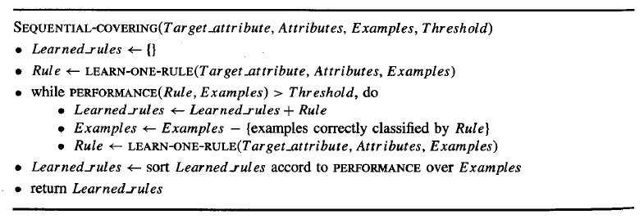

Slide 8
Contd..
It reduces the problem of learning a disjunctive set of rules to a sequence of simpler problems.
It performs a greedy search, formulating a sequence of rules without backtracking, it is not guaranteed to find the smallest or best set of rules that cover the training examples.
How shall we design LEARN-ONE-RULE to meet the needs of the sequential covering algorithm?

Slide 9
Contd..
General to Specific Beam Search
One effective approach to implementing LEARN-ONE-RUL E is to organize the hypothesis space search in the same general fashion as the ID3 algorithm.
The search begins by considering the most general rule precondition possible.
Then greedily adding the attribute test that most improves rule performance measured over the training examples.
Once this test has been added, the process is repeated by greedily adding a second attribute test, and so on.

Slide 10
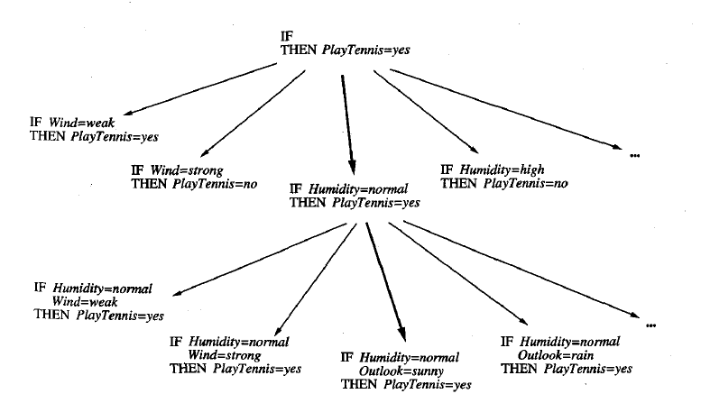

Slide 11
Contd..
This process grows the hypothesis by greedily adding new attribute tests until the hypothesis reaches an acceptable level of performance.
It follows only a single descendant at each search step-the attribute-value
pair yielding the best performance.
As with any greedy search, there is a danger that a suboptimal choice will be made at any step .
To reduce this risk, we can extend the algorithm to perform a beam search

Slide 12
Contd..
The algorithm maintains a list of the k best candidates at each step, rather than a single best candidate.
On each search step, descendants are generated for each of these k best candidates, and the resulting set is again reduced to the k most promising members.
Beam search keeps track of the most promising alternatives to the current top-rated hypothesis

Slide 13
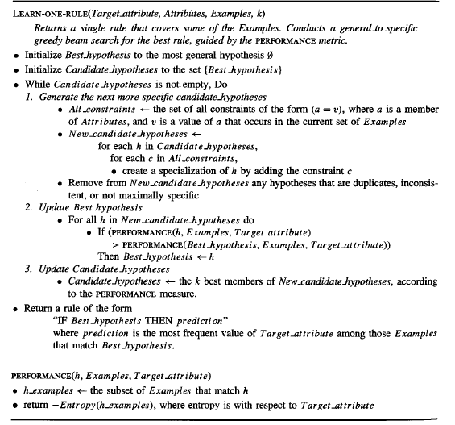

Slide 14
Contd..
Remarks:
Each hypothesis considered in the main loop of the algorithm is a conjunction of attribute-value constraints.
Each of these conjunctive hypotheses corresponds to a candidate set of preconditions for the rule to be learned and is evaluated by the entropy of the examples it covers.
The search considers increasingly specific candidate hypotheses until it reaches a maximally specific hypothesis that contains all available attributes.
The rule that is output by the algorithm is the rule encountered during the search whose PERFORMANCE is greatest.

Slide 15
Contd..
Variations:
The SEQUENTIAL-COVERING algorithm, together with the LEARN-ONE-RULE algo rithm, learns a set of if-then rules that covers the training examples.
Many variations on this approach have been explored.
In some cases it might be desirable to have the program learn only rules that cover positive examples and to include a "default" that assigns a negative classification to instances not covered by any rule.
The LEARN-ONE-RULE algorithm can be modified to accept an additional input argument specifying the target value of interest.

Slide 16
Contd..
Another variation is provided by a family of algorithms called AQ that predate the CN2 algorithm on which the above discussion is based.
AQ learns a disjunctive set of rules that together cover the target function.
It explicitly seeks rules that cover a particular target value, learning a disjunctive set of rules for each target value in turn.
It considers only those attributes satisfied by the positive example as it searches for progressively more specific hypotheses.

Slide 17
Summary
Sequential covering algorithms learn one rule at a time, removing the covered examples and repeating the process on the remaining examples.
Whereas ID3 is a simultaneous covering algorithms as learn the entire set of disjuncts simultaneously as part of the single search.
CN2 chooses among alternative attribute-value pairs, by comparing the subsets of data they cover.
Whereas ID3 chooses among alternative attributes by comparing the partitions of the data they generate.

Slide 18
Contd..
To learn a set of n rules, each containing k attribute-value tests in their preconditions, sequential covering algorithms will perform n . k primitive search steps.
Simultaneous covering algorithms will make many fewer independent choices.
Thus, sequential covering algorithms such as CN2 make a larger number of independent choices than simultaneous covering algorithms such as ID3.

Slide 19
Contd…
A second dimension along which approaches vary is the direction of the search in LEARN-ONE-RULE.
A third dimension is whether the LEARN-ONE-RULE search is a generate then test search through the syntactically legal hypotheses.
A fourth dimension is whether and how rules are post-pruned.
A final dimension is the particular definition of rule PERFORMANCE used to
guide the search in LEARN-ONE-RULE.

Slide 20


Some common functions:
Relative frequency. Let n denote the number of examples the rule matches and let nc denote the number of these that it classifies correctly.
m-estimate of accuracy:It is often preferred when data is scarce and the rule must be evaluated based on few examples.

Slide 21

Contd..
Entropy:Entropy measures the uniformity of the target function values for this set of examples.

Slide 22
LEARNING FIRST-ORDER RULES
We consider here learning rules that contain variables-in particular, learning first-order Horn theories.
Our motivation for considering such rules is that they are much more expressive than propositional rules.
Inductive learning of first-order rules or theories is often referred to as inductive logic programming

Slide 23
First-Order Horn Clauses
Consider the task of learning the simple target concept Daughter (x, y), defined over pairs of people x and y.
The value of Daughter(x, y) is True when x is the daughter of y, and False otherwise.
Each person in the data is described by the attributes Name, Mother, Father, Male, Female.
Each training example will consist of the description of two people in terms of these attributes, along with the value of the target attribute Daughter.

Slide 24
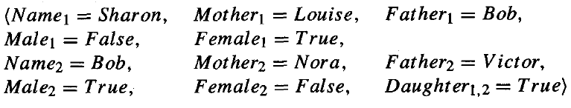
The following is a positive example in which Sharon is the daughter
If we were to collect a number of such training examples for the target concept Daughter_{l,2} and provide them to a propositional rule learner such as CN2 or C4.5.

Slide 25
Contd..
The result will be as follows:
This rule is so specific that it will rarely, if ever, be useful in classifying future pairs of people.
The problem is that propositional representations offer no general way to describe the essential relations among the values of the attributes.

Slide 26
Contd..
A program using first-order representations could learn the following general rule:
x and y are variables that can be bound to any person.
First-order Horn clauses may also refer to variables in the preconditions that
do not occur in the postconditions.

Slide 27

Contd..
Ex:
such variables occurs only in the preconditions are assumed to be existentially quantified.
If we use the same predicates in the rule postconditions and preconditions, enabling the description of recursive rules.

Slide 28
Terminology
All expressions are composed of constants (e.g., Bob, Louise), variables (e.g., x, y), predicate symbols (e.g., Married, Greater-Than), and function symbols (e.g., age).
We will use lowercase symbols for variables and capitalized symbols for constants.
A term is any constant, any variable, or any function applied to any term (e.g., Bob, x, age(Bob)).

Slide 29

A literal is any predicate or its negation applied to any term (e.g., Married(Bob, Louise), -Greater-Than(age(Sue), 20)).
A clause is any disjunction of literals, where all variables are assumed to be
universally quantified.
A Horn clause is a clause containing at most one positive literal, such as

Slide 30


The above Horn clause can alternatively be written in the form
This is equivalent to the following, using our earlier rule notation

Slide 31
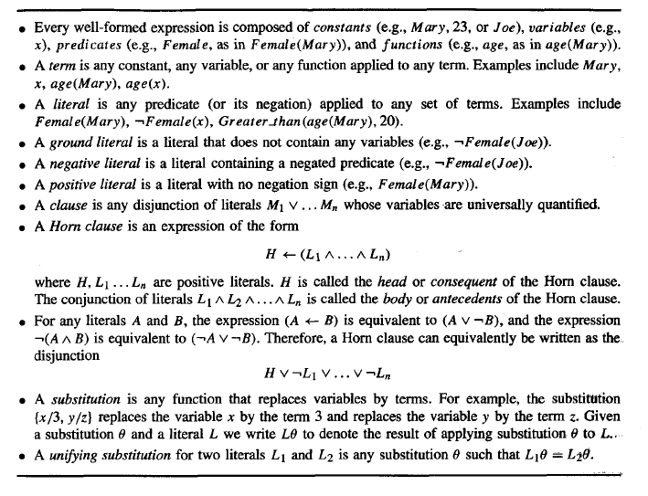

Slide 32
FOIL
It employs an approach very similar to the SEQUENTIAL-COVERING and LEARN-ONERULE algorithms of the previous section.
The hypotheses learned by FOIL are sets of first-order rules, where each rule is similar to a Horn clause with two exceptions.
The rules learned by FOIL are more restricted than general Horn clauses.
FOIL rules are more expressive than Horn clauses,
FOIL has been applied to a variety of problem domains.

Slide 33
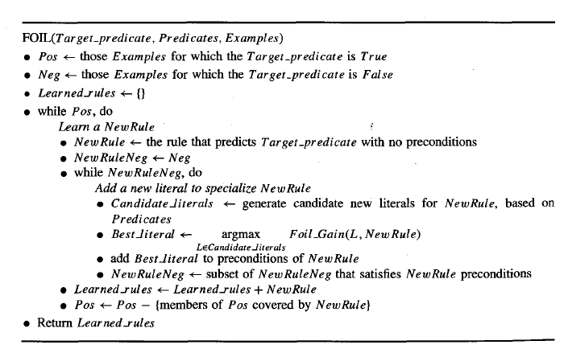

Slide 34
Contd..
Differences are
In its general-to-specific search to 'learn each new rule, FOIL employs different detailed steps to generate candidate specializations of the rule.
FOIL employs a PERFORMANCE measure, Foil-Gain, that differs from the entropy measure shown for LEARN-ONE-R

Slide 35

Contd..
Generating Candidate Specializations in FOIL
FOIL generates a variety of new literals, each of which may be individually added to the rule preconditions.
FOIL generates candidate specializations of this rule by considering new literals L n+1 that fit one of the following forms:
At least one of the value in the created literal must already exist as a variable in the rule.

Slide 36

Contd..
Equal(xj, xk), where xi and xk are variables already present in the rule.
The negation of either of the above forms of literals.
Ex: consider learning rules to predict the target literal Grand- Daughter(x, y), where the other predicates used to describe examples are Father and Female.

Slide 37

Contd..
To specialize this initial rule, the above procedure generates the following literals as candidate additions to the rule preconditions: Equal ( x , y ) , Female(x), Female(y), Father(x, y), Father(y, x), Father(x, z), Father(z, x), Father(y, z), Father- (z, y), and the negations of each of these literals (e.g., -Equal(x, y)).
Among the above literals FOIL greedily selects Father- ( y , z) as the most promising, leading to the more specific rule

Slide 38
Contd…
FOIL will now consider all of the literals mentioned in the previous step, plus the additional literals Female(z), Equal(z, x), Equal(z, y), Father(z, w), Father(w, z), and their negations.
If FOIL at this point were to select the literal Father(z, x) and on the
next iteration select the literal Female(y), this would lead to the following rule

Slide 39
Guiding the Search in FOIL
To select the most promising literal from the candidates generated at each step, FOIL considers the performance of the rule over the training data.
To illustrate this process, consider again the example in which we seek to learn a set of rules for the target literal GrandDaughter(x, y).
Assume the training data includes the following simple set of assertions

Slide 40
Contd..
To select the best specialization of the current rule, FOIL considers each
distinct way in which the rule variables can bind to constants in the training
examples.
The rule variables x and y are not constrained by any preconditions and may
therefore bind in any combination to the four constants Victor, Sharon, Bob, and
Tom

Slide 41
Contd..
We will use the notation {x/Bob, y/Shar on} to denote a particular variable
binding; that is, a substitution mapping each variable to a constant.
Given the four possible constants, there are 16 possible variable bindings for this initial rule.
The binding {xlvictor, ylSharon} corresponds to a positive example binding, because
the training data includes the assertion GrandDaughter(Victor, Sharon).
The other 15 bindings allowed by the rule (e.g., the binding {x/Bob, y/Tom}) constitute negative evidence

Slide 42
Contd..
At each stage, the rule is evaluated based on these sets of positive and negative variable bindings, with preference given to rules that possess more positive bindings and fewer negative bindings.
As new literals are added to the rule, the sets of bindings will change.
If a literal is added that introduces a new variable, then the bindings for the rule will grow in length (e.g., if Father(y, z) is added to the above rule, then the original binding({xlvictor, ylSharon, z/Bob).

Slide 43
Contd..
The evaluation function used by FOIL to estimate the utility of adding a new literal is based on the numbers of positive and negative bindings covered before and after adding the new literal.
More precisely, consider some rule R, and a candidate literal L that might be added to the body of R. Let R' be the rule created by adding literal L to rule R.
The value Foil-Gain(L, R) of adding L to R is defined as

Slide 44

Contd..
po is the number of positive bindings of rule R,
no is the number of negative bindings of R,
pl is the number of positive bindings of rule R', and
nl is the number of negative bindings of R'.
Finally, t is the number of positive bindings of rule R that are still covered after adding literal L to R.

Slide 45
Learning Recursive Rule Sets
If we include the target predicate in the input list of Predicates, then FOIL will consider it as well when generating candidate literals.
This will allow it to form recursive rules-rules that use the same predicate in
the body and the head of the rule.
IF Parent (x, y) THEN Ancestor(x, y)
IF Parent (x, z) A Ancestor(z, y) THEN Ancestor(x,y)

Slide 46
Contd..
The second rule is among the rules that are potentially within reach of FOIL'S search, provided Ancestor is included in the list Predicates that determines which predicates may be considered when generating new literals.
Of course whether this particular rule would be learned or not depends on whether these particular literals outscore competing candidates during FOIL'S greedy search for increasingly specific rules

